Slide 1
第十三章 生成器模式
生成器模式
将一个复杂对象的构建与它的表示分离，使得同样的构建过程可以创建不同的表示。
Builder Pattern
Separate the construction of a complex object from its representation so that the
same construction process can create different representations.

Slide 2
一 、 概述
当系统准备为用户提供一个内部结构复杂的对象时，就可以使用生成器模式，使用该模式可以逐步地构造对象，使得对象的创建更具弹性。生成器模式的关键是将一个包含有多个组件对象的创建分成若干个步骤，并将这些步骤封装在一个称作生成器的接口中。

Slide 3
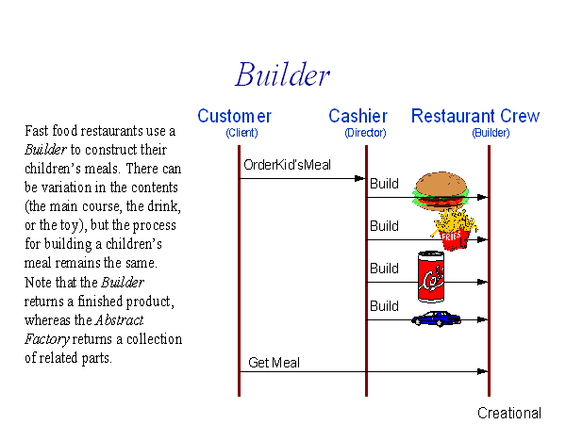

Slide 4
二、生成器模式的结构与使用
模式的结构中包括四种角色：
产品（Product）
抽象生成器（Builder）
具体生成器（ConcreteBuilder）
指挥者（Director）

Slide 5
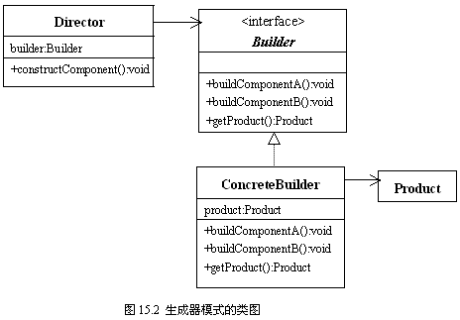
模式的UML类图

Slide 6
模式的结构的描述与使用
创建含有按钮、标签和文本框组件的容器。不同用户对容器有不同的要求，比如某些用户希望容器中只含有按钮和标签，某些用户希望容器只含有按钮和文本框等。另外，用户对组件在容器中的顺序位置也有不同的要求，比如某些用户要求组件在容器中从左至右的排列顺序是按钮、标签、文本框，而某些用户要求从左至右的排列顺序是标签、文本、按钮等。

Slide 7
1．产品（Product）: PanelProduct.java
import javax.swing.*;
public class PanelProduct extends JPanel{
JButton button;
JLabel label;
JTextField textField;
}

Slide 8
2．抽象生成器（Builder）: Builer.java
import.javax.swing.*;
public interface Builder{
public abstract void buildButton();
public abstract void buildLabel();
public abstract void buildTextField();
public abstract JPanel getPanel();
}

Slide 9
3．具体生成器（ConcreteBuilder）_1:ConcreteBuilderOne.java
import javax.swing.*;
public class ConcreteBuilderOne implements Builder{
private PanelProduct panel;
ConcreteBuilderOne(){
panel=new PanelProduct();
}
public void buildButton(){
panel.button=new JButton("按钮");
}
public void buildLabel(){
panel.label=new JLabel("标签");
}

Slide 10
public void buildTextField(){
panel.textField=new JTextField("文本框");
}
public JPanel getPanel(){
panel.add(panel.button);
panel.add(panel.label);
panel.add(panel.textField);
return panel;
}
}

Slide 11
3．具体生成器（ConcreteBuilder）_2:ConcreteBuilderTwo.java
import javax.swing.*;
public class ConcreteBuilderTwo implements Builder{
private PanelProduct panel;
ConcreteBuilderTwo(){
panel=new PanelProduct();
}
public void buildButton(){
panel.button=new JButton("button");
}
public void buildLabel(){
panel.label=new JLabel("label");
}

Slide 12
public void buildTextField(){
panel.textField=new JTextField("textField");
}
public JPanel getPanel(){
panel.add(panel.textField);
panel.add(panel.label);
panel.add(panel.button);
return panel;
}
}

Slide 13
4．指挥者（Director）:Director.java
import javax.swing.*;
public class Director{
private Builder builder;
Director(Builder builder){
this.builder=builder;
}
public JPanel constructProduct(){
builder.buildButton();
builder.buildLabel();
builder.buildTextField();
JPanel product=builder.getPanel();
return product;
}
}

Slide 14
5．应用 Application.java
import javax.swing.*;
public class Application{
public static void main(String args[]){
Builder builder=new ConcreteBuilderOne();
Director director=new Director(builder);
JPanel panel=director.constructProduct();
JFrame frameOne=new JFrame();
frameOne.add(panel);
frameOne.setBounds(12,12,200,120);
frameOne.setDefaultCloseOperation(JFrame.DISPOSE_ON_CLOSE);
frameOne.setVisible(true);

Slide 15
builder=new ConcreteBuilderTwo();
director=new Director(builder);
panel=director.constructProduct();
JFrame frameTwo=new JFrame();
frameTwo.add(panel);
frameTwo.setBounds(212,12,200,120);
frameTwo.setDefaultCloseOperation(JFrame.DISPOSE_ON_CLOSE);
frameTwo.setVisible(true);
}
}

Slide 16
三、生成器模式的优点
生成器模式将对象的构造过程封装在具体生成器中，用户使用不同的具体生成器就可以得到该对象的不同表示。
生成器模式将对象的构造过程从创建该对象的类中分离出来，使得用户无须了解该对象的具体组件。
可以更加精细有效地控制对象的构造过程。生成器将对象的构造过程分解成若干步骤，这就使得程序可以更加精细，有效地控制整个对象的构造。
生成器模式将对象的构造过程与创建该对象类解耦，使得对象的创建更加灵活有弹性。
当增加新的具体生成器时，不必修改指挥者的代码，即该模式满足开-闭原则。

Slide 17
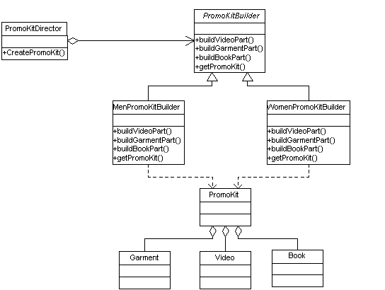
四、应用举例（一）

Slide 18
public abstract class PromoKitBuilder {
protected PromoKit promoKit = new
PromoKit();
public abstract void buildVideoPart();
public abstract void buildGarmentPart();
public abstract void buildBookPart();
public abstract PromoKit getPromoKit();
}

Slide 19
public class MenPromoKitBuilder extends PromoKitBuilder {
public void buildVideoPart() {
// add videos to PromoKit based on men-specific
preferences }
public void buildGarmentPart() {
// add men garments to PromoKit }
public void buildBookPart() {
// add books to PromoKit based on men-specific
preferences }
public PromoKit getPromoKit() {
return promoKit; }
}

Slide 20
public class WomenPromoKitBuilder extends PromoKitBuilder {
public void buildVideoPart() {
// add videos to PromoKit based on
women-specific preferences }
public void buildGarmentPart() {
// add women garments to PromoKit }
public void buildBookPart() {
// add books to PromoKit based on
women-specific preferences }
public PromoKit getPromoKit() {
return promoKit;
}
}

Slide 21
// Director
public class PromoKitDirector {
public PromoKit createPromoKit(PromoKitBuilder builder) {
builder.buildVideoPart();
builder.buildGarmentPart();
builder.buildBookPart();
return builder.getPromoKit();
}
}

Slide 22
public class Application {
public static void main(String[] args) {
String gendre = "M";
PromoKitDirector director = new PromoKitDirector();
PromoKitBuilder promoKitBuilder = null;
if (gendre.equals("M")) {
promoKitBuilder = new MenPromoKitBuilder(); }
else if (gendre.equals("F")) {
promoKitBuilder = new WomenPromoKitBuilder(); }
else { // .... }
PromoKit result = director.getPromoKit(promoKitBuilder);
}
}

Slide 23
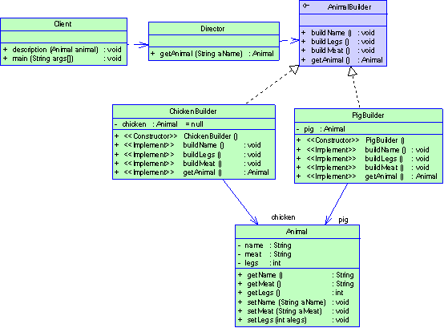
五、应用举例（二）

Slide 24
public interface AnimalBuilder{
public void buildName();
public void buildLegs();
public void buildMeat();
public Animal getAnimal();
}

Slide 25
public class ChickenBuilder implements AnimalBuilder{
private Animal chicken = null;
public ChickenBuilder(){
chicken = new Animal();
}
public void buildName(){
chicken.setName("chicken");
}
public void buildLegs(){
chicken.setLegs(2);
}

Slide 26
public void buildMeat(){
chicken.setMeat("chicken");
}
public Animal getAnimal(){
buildName();
buildLegs();
buildMeat();
return chicken;
}
}

Slide 27
public class Animal{
private String name;
private String meat;
private int legs;
public String getName(){
return name;
}
public String getMeat(){
return meat;
}
public int getLegs(){
return legs;
}
public void setName(String aName){
name = aName;
}
public void setMeat(String aMeat){
meat = aMeat;
}
public void setLegs(int alegs){
legs = alegs;
}
}

Slide 28
public class Director{
public Animal getAnimal(String aName){
if(aName.equals("chicken")){
return new ChickenBuilder().getAnimal();
}
else if(aName.equals("pig")){
return new PigBuilder().getAnimal();
}
else return null;
}
}

Slide 29
public class Client{
public static void description(Animal animal){
String desc = "This animal is called "+animal.getName();
desc +="\n Its meat is "+animal.getMeat();
desc +="\n And it has "+animal.getLegs()+" legs.";
System.out.println(desc);
}

Slide 30
public static void main(String[] args){
String aName = "chicken";
Director d = new Director();
Animal animal =d.getAnimal(aName);
description(animal);
aName = "pig";
animal = d.getAnimal(aName);
description(animal);
}
}

